Slide 1


Slide 2


Part 2
MINI SOnar
Mohit Kishore (1701CS28)

Slide 3
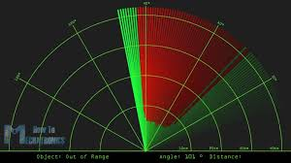
MINI-SONAR
This project has been made with an aim to understand the working of an Arduino.
I have made a mini, compact SOnar with display. For hat, I have used an HC-SR04 ultrasonic sensor, a sensor which emits ultrasonic sound and comes back to sensor after reflecting from an object.

Slide 4


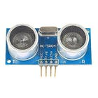
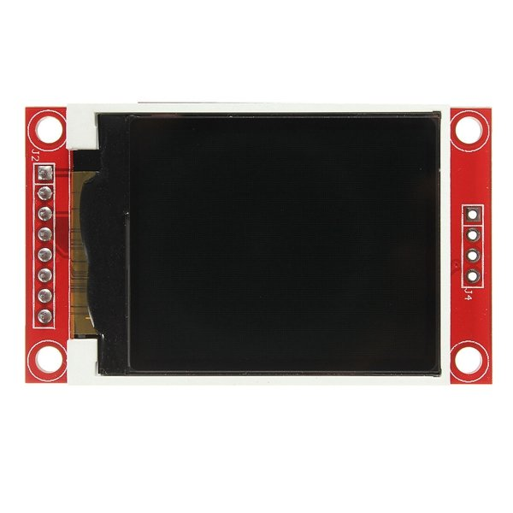
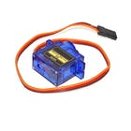
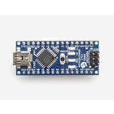
Components USED:
HC-SR04 ULTRASONIC SENSOR
1.8” ST7735 DISPLAY
SG90 MICROSERVO
ARDUINO NANO

Slide 5
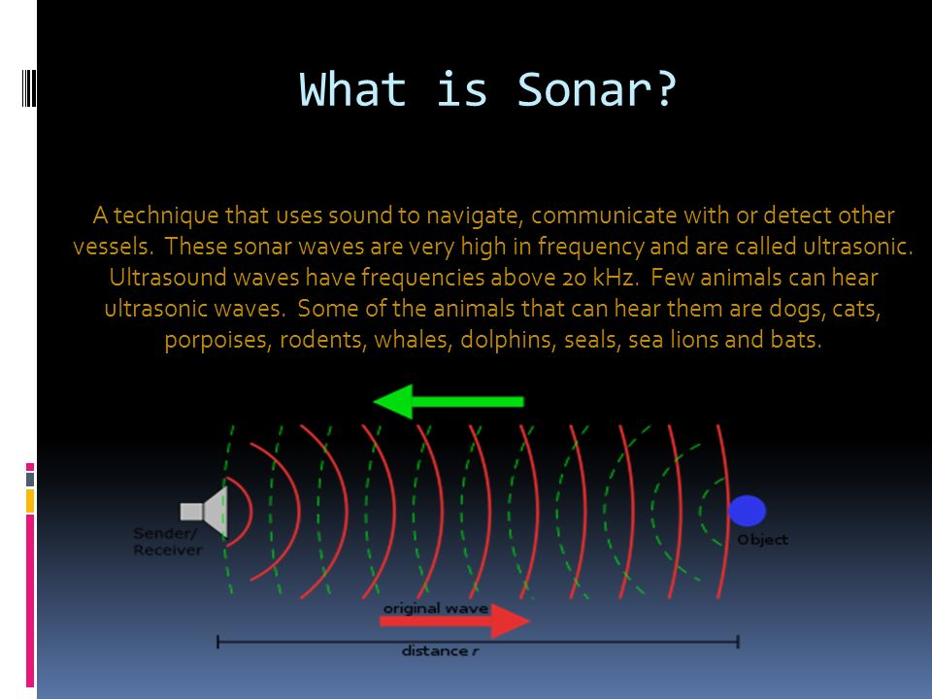
SONAR
Sonar is a device used to detect underwater objects using sound waves.
In this system a sound pulse is generated and sent underwater through a transmitter.
Sound waves are reflected by the underwater object which are received at receiver.
The time taken by sound wave to come back is recorded.
And by knowing the speed of sound wave in water the distance can be easily be calculated by formula,
distance= speed x time.

Slide 6
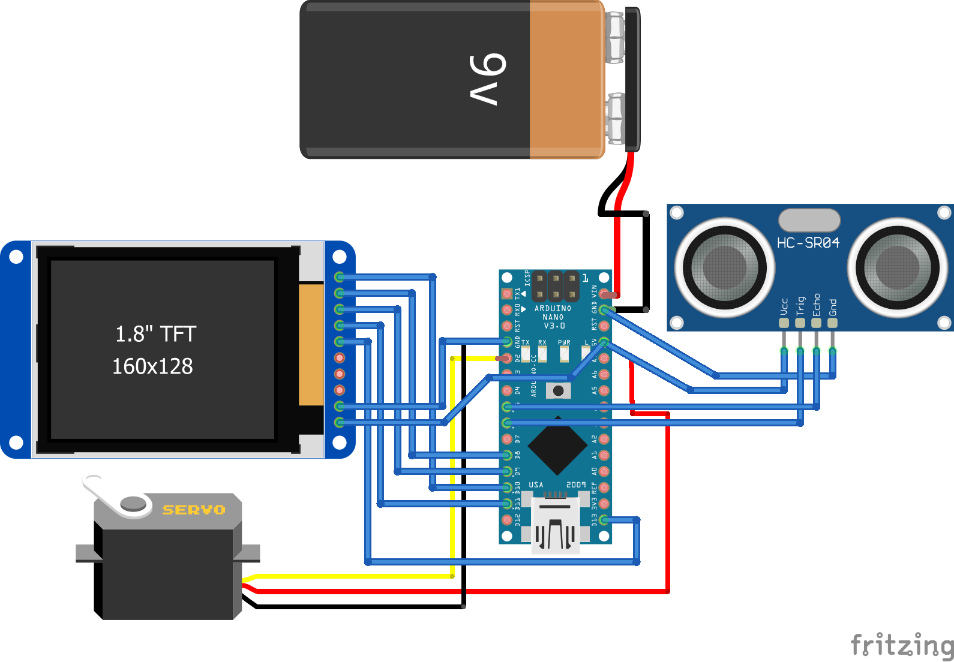
CIRCUIT DIAGRAM

Slide 7
LOOKING AT THE BIGGER PICTURE: APPLICATION:
The concept of sonar finds application in the following places:
It is used for estimation of range and direction of arrival of objects such as vessels or submarines. It basically functions as depth finder also.
It is used for communication between sub-merged submarines or between a submarine and a surface vessel.
It is used for locating mines and underwater hazards in order to achieve safe navigation.
It is widely used by commercial fishermen for fish finding.
It is used for seafloor mapping and seafloor imaging.
SONAR concept is being applied to medical imaging. Here high frequency sound waves are subjected on body and echoes are recorded to create image called sonogram.

Slide 8
THANK YOU

